Slide 1

Building a Responsive
Single Page App
Allen Conway
Senior Consultant
Level: Intermediate

Slide 2


Intro
Allen Conway
Blog: http://www.AllenConway.net
Twitter: @AllenConway, http://www.twitter.com/AllenConway
GitHub: https://github.com/AllenConway
AllenC@Magenic.com

Slide 3

Target Objective
Single Page Applications
What exactly is a SPA?
Why SPAs are viable
SPAs vs. ASP.NET
Progressing to the Modern Web App
The Web Stack
Responsive Web Design
AngularJS + TypeScript
Azure Websites and Mobile Services
ASP.NET Web Pages
Web API
SignalR

Slide 4
Let’s get things rolling
“To say that SPA development is the future is an extreme understatement”
Long Le, MSDN Magazine (March 2014)
“Yep – I agree.”
Allen Conway (November 2014)

Slide 5
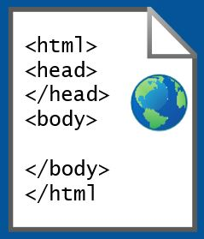
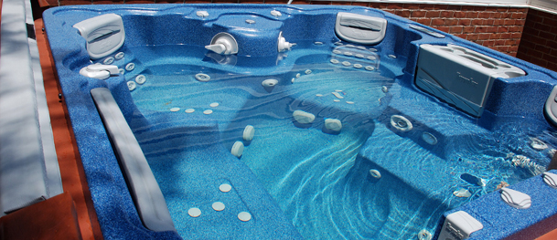
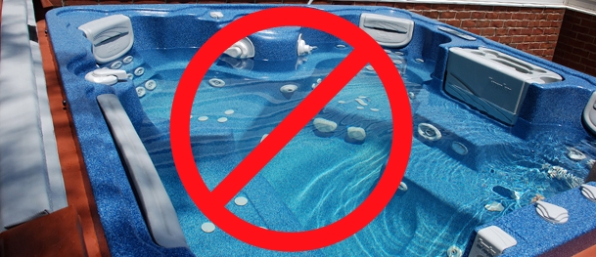
What exactly is a SPA??
Single Page Application
What’s with the ‘Single Page’ – Do I have to do everything in 1 page?
HTML web page “shell” is sent once to the browser

Slide 6
Cross Browser, Platform, Device
SPAs + Responsive design
Browser and device agnostic
Best on browsers supporting HTML5 and CSS3
http://caniuse.com/
More accepted on mobile devices
JavaScript will rule the world!!
Should I go to the web?
Native per platform
Xamarin
Hybrid/PhoneGap
http://magenic.com/Resources/WhitePapers/ChoosingTheRightMobileTechnology

Slide 7
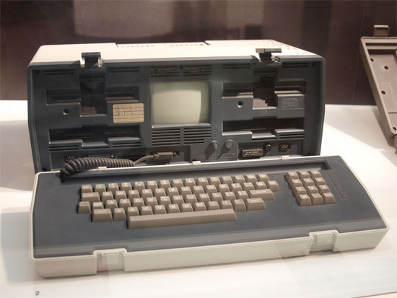
MyVote – Single Page Application DEMO
SPAs can run on almost anything with a modern browser!

Slide 8
How are SPAs different from ASP.NET MVC or Webforms?
Shift in application logic from the server to the client
UI and application logic is now done in the browser
How HTML is delivered
ASP.NET web apps merge data with HTML before delivering to the client
Server’s main responsibility: Data
JavaScript MV* Frameworks

Slide 9
Where did we come from?
Static DOM
Static DOM
Static DOM
Static/Dynamic
DOM
Code-Behind
Controller
Controller
Services / Data

Slide 10
The Modern Web: Single Page Applications
Master Layout
Model
View
(Dynamic DOM)
Controller
Services
Renderer
Services / Data

Slide 11


SPAs in the Enterprise
The popular SPAs
Gmail, Twitter, and Google Maps
Making that accounting, shipment tracking, inventory, etc. application as a SPA
Considerations before making that next application a SPA

Slide 12

Why SPAs are… AWESOME
Lean, mean, fighting machines!
SPAs are fluid and responsive
Narrowing the line between desktop and web from UX perspective
Mature browsers
HTML5
CSS3
JS Processing
SPA Frameworks follow familiar patterns

Slide 13

Disadvantages and Challenges of SPAs
Frameworks are volatile
Take notice: JavaScript is required
Sea of JS frameworks for SPAs
Years of working almost exclusively in managed code on the server (C#/VB.NET)
Mindset of doing so much on the client
Difference in the way of thinking about web design

Slide 14
Common Misunderstandings of SPAs
Not SEO friendly because there is no static content to crawl
I can’t have deep linking
I have 25+ pages in my app not ‘a single page’
JS Frameworks are fads that will be gone in 5 years

Slide 15

The MyVote SPA Technology Stack
HTML5/CSS3 Responsive Design
AngularJS + TypeScript
Azure Web Sites and Azure Mobile Services
ASP.NET Web Pages (not MVC!)
ASP.NET Web API
CSLA
Azure SQL Server

Slide 16

Responsive Design
Further elevate your code :: eyeball ratio
Foot in the door for mobile devices
Invest in your base template
Core technique: CSS Media Queries (CSS3)
Tools for testing

Slide 17
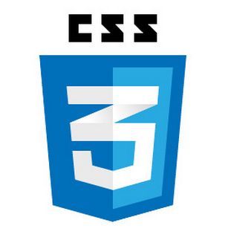

MyVote - Responsive Web Design DEMO

Slide 18

JavaScript and SPAs
Let’s not sugar coat it – we need JS
Object.prototype.__proto__
Follow mainstream JS patterns
Modules (Module & Revealing Module Patterns)
Closures
Promises
Leverage JS SPA frameworks and Libraries
AngularJS
Durandal
Backbone
Ember

Slide 19

AngularJS
Complete client side MVW framework for creating SPAs
Compliments the server
Originally started at Google, now OSS
Declarative style of programming
Manipulating the DOM
Imperative style of programming
Expressing logic
Easy to use and learn

Slide 20
AngularJS Fundamentals
Comprehensive framework includes:
Data binding
Directives
Templates/Views
Controllers
Models
Services
Custom and Provided
Dependency Injection

Slide 21
TypeScript
Type-safe, statically-verified JavaScript
IntelliSense!
Familiar paradigms
Leverage your C# classes
TypeScript with AngularJS
Module = app
Class = controller, service, etc.
TypeLITE
Generates TypeScript definitions from .NET classes

Slide 22
ASP.NET Web API
RESTful services
We can still use C#/VB.NET on the server!
Server holds the cards to providing data to the client
MVC developer-friendly
AJAX-friendly

Slide 23
MyVote – AngularJS, TypeScript, Web Pages, and Web API DEMO

Slide 24
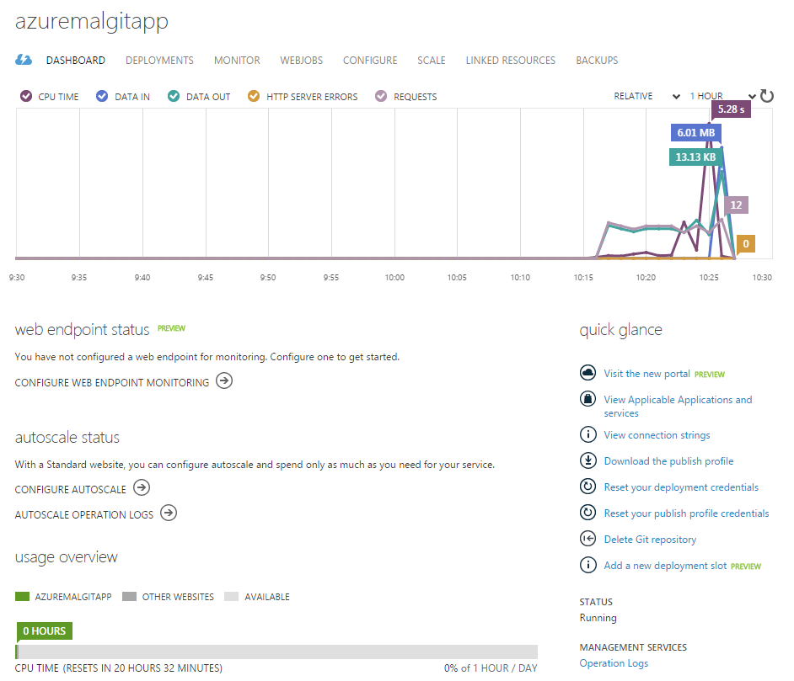

Azure Websites
Host your own web applications
Multiple hosting options
Multiple Source Control Integration Options
Azure Management Portal
Easy to use – no IIS or server to manage

Slide 25

Azure Mobile Services
Platform parity
Facilitate a shared experience
Identity
Data/Sync
Notifications
Backend jobs
Push Notification support
Fastest way to get up and running

Slide 26
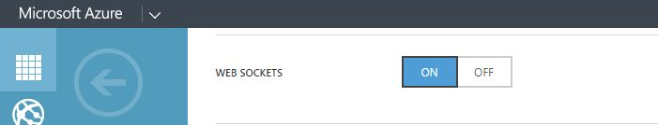
SignalR
Real-time push communication
Notifications, streaming, etc.
Azure Web Sites supports Web Sockets

Slide 27

MyVote – SignalR DEMO

Slide 28

SPA Performance
The big payoff – fast, fast, fast and don’t forget… efficient!
Use ‘Network’ tab in debugging tools
Request count
Size
Time
Techniques
Caching
Bundling / Minification
Application Insights

Slide 29
Learning to befriend the Developer Tools
Chrome, IE, Firefox and Safari all have their own developer tools
Chrome has a fantastic set of developer tools
Search for scripts using Ctrl + O
Ability to debug JavaScript and seek out errors easily
Ability to debug Async calls
Manipulate expressions real time to prevent browser refresh

Slide 30
Useful References
MyVote on GitHub
https://github.com/Magenic/MyVote
Plunker
http://plnkr.co/
AngularJS API Docs
https://docs.angularjs.org/api
AngularJS Training
http://egghead.io/
http://thinkster.io/
http://www.pluralsight.com/
Bootstrap
http://getbootstrap.com/
UI Bootstrap (Angular directives)
http://angular-ui.github.io/bootstrap/

Slide 31
Not a wrap up!
This is just the Start!
Have references handy
Try things on a small scale
Become familiar with all the pieces
SPAs and Modern Applications
way of thinking/designing vs. technologies that implement them
SPAs can create large scalable web applications

Slide 32

Questions
Thank you for attending Modern Apps LIVE!

